Slide 1
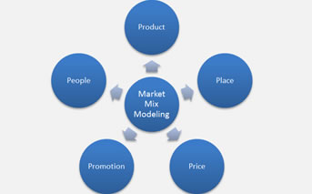
Media Mix Modeling using Simultaneous Equations
Akshay Kher
Akshay Kher
April 8, 2016

Slide 2
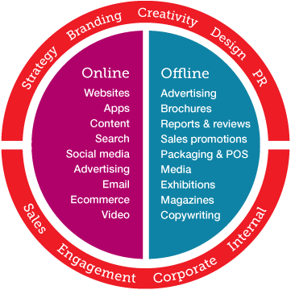
Background / Objective
Background
Marketers use various marketing vehicles like Television, Digital, Direct Mail, Email, Print, Radio, etc. Marcomm expenses differ by channel. Understanding the effectiveness of marcomm by channel is critical to success.
Objective
Which media mix vehicle drives units, awareness, visits? What percent of budget should go into each media mix vehicle? Which media mix vehicle will drive most revenue? What is the effect of SOV? How much does ‘out of window’ spend drive revenue?
Data
2 years of weekly data. Media mix spend by vehicle.
Competitor spend.

Slide 3
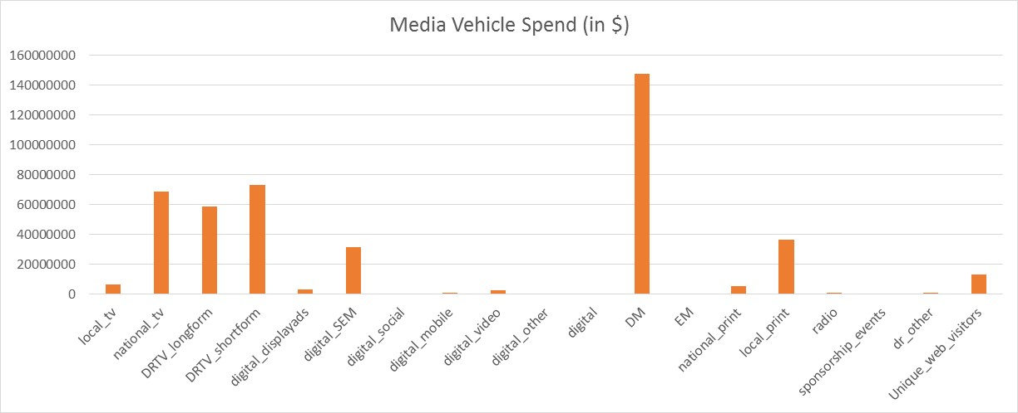
Highest spend is on Direct Mail followed by TV

Slide 4
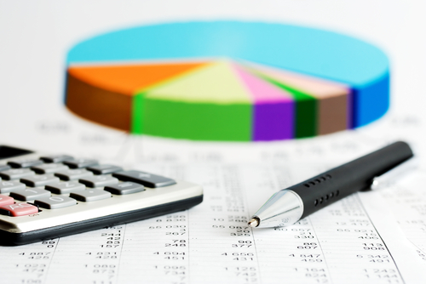
Which media vehicle drives units, awareness and visits? By how much do awareness and visits drive units?

Slide 5
Media Mix Modeling
Modeling Steps:
Checked influential observations. Created positive and negative outlier variables
Checked and corrected for autocorrelation using Cochrane-Orcutt procedure
Procedure Used: Proc Syslin 2SLS
Endogenous Variables: Sales, Unique_web_visitors, Unaided_Awareness
Instruments: window, sales_lag1, positive, digital_displayads, digital_SEM, digital_mobile, digital_video, digital, digital_SEM_National_print, DM, EM, national_print, local_print, radio, sponsorship_events, dr_other, Unique_web_visitors_lag1, sov

Slide 6
Units Model
Variable | Estimate | % Lift
Unaided Awareness | 0.8009 | 8.0%
Unique Web Visitors | 0.2249 | 2.2%
Digital SEM Local Print | 0.3310 | 13.3%
National Print | 0.1453 | 11.5%
National TV | -0.2742 | -2.7%
Digital SEM | -3.4008 | -14.0%
Local Print | -3.9168 | -19.2%
Unaided Awareness and Web Visitors affect units positively
Digital SEM Local Print and National Print help drive units positively
National TV, Local Print and Digital Print affect units negatively

Slide 7
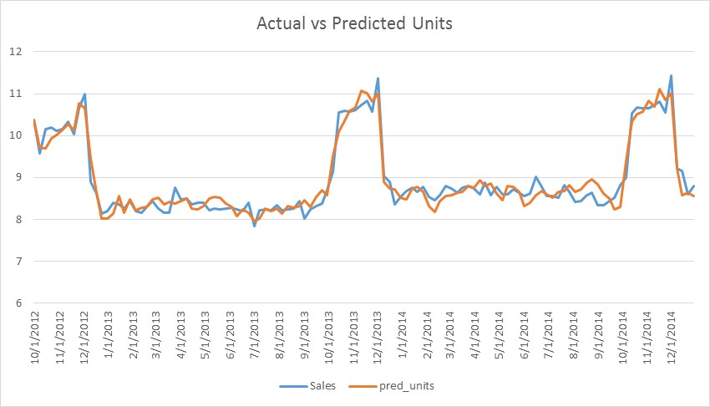
Units Model
R sq = 92.5%
An R-sq of 92.5% indicates that the model successfully captures the movement in units over time

Slide 8
Web Visitors Model
Variable | Estimate | % Lift
Unaided Awareness Lag1 | 0.4417 | 4.4%
Digital SEM | 1.3261 | 13.3%
Local Print | 1.2778 | 12.8%
DRTV Long form | 0.4954 | 5.0%
Digital SEM Local Print | -0.1062 | -1.1%
DRTV Short form | -0.6448 | -6.4%
Unaided Awareness affects web visitors positively to the extent of 4.4%
Major drivers of Web Visitors include Digital SEM and Local Print and DRTV Long form
DRTV Short form and Digital SEM Local Print affect Web Visits negatively

Slide 9
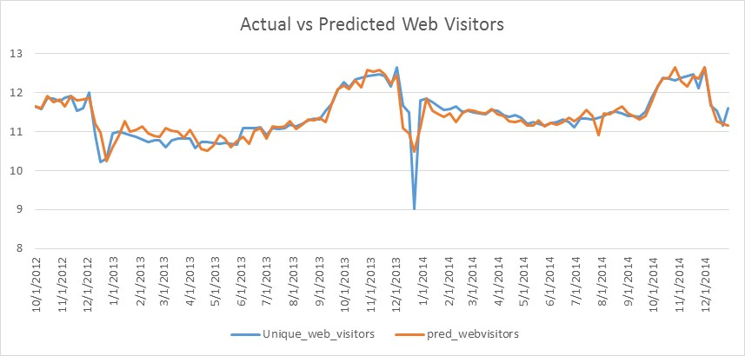
Web Visitors Model
R sq = 78.5%
An R-sq of 78.5% indicates that the model captures the movement in web visitors over time relatively well. It fails to accurately capture the drop in the beginning of 2014.

Slide 10
Unaided Awareness Model
Variable | Estimate | % Lift
Unaided Awareness Lag1 | 0.6757 | 6.8%
DRTV Long form | 0.0743 | 11.7%
Direct Mail | 0.0861 | 9.9%
Local Print | 0.1299 | 7.3%
National Print | 0.0207 | 2.2%
DRTV Short form | -0.0214 | -2.7%
Lag of Unaided Awareness affects awareness positively to the extent of 6.8%
Major drivers of Unaided Awareness include DRTV Long Form, Direct Mail, Local Print and National Print
DRTV Short form affects Unaided Awareness negatively

Slide 11
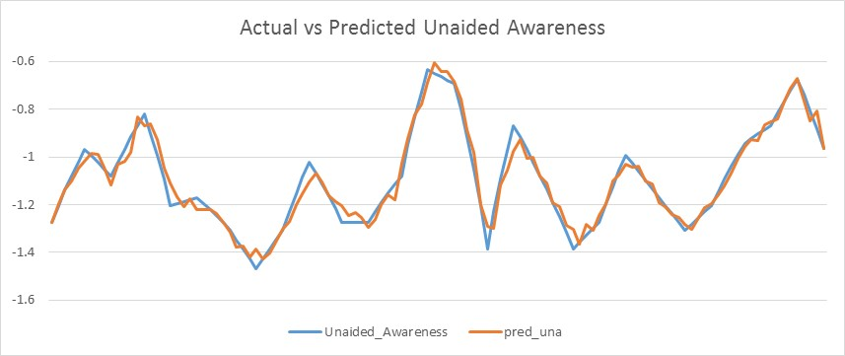
Unaided Awareness Model
R sq = 95.4%
An R-sq of 95.4% indicates that the model successfully captures the movement in unaided awareness over time

Slide 12
Share of Voice
Model | Estimate | % Lift
Units Model | -0.09 | -0.9%
Web Visitors Model | 0.01 | 0.1%
Unaided Awareness Model | 0.0014 | 0.01%
Share of voice has been calculated as the ratio of client spend to competitor spend
It has limited overall impact to the health insurance client
It affects the units model in a negative way to the extent of -0.9%
It affects the web visitors model and unaided awareness model in a slightly positive way to the extent of 0.1% and 0.01% respectively

Slide 13
‘Out Of Window’ spend
Modeling Steps:
Procedure Used: Type 2 Tobit
Endogenous Variables: Units
Censoring Variable: Window
In Window spend affects units positively to the extent of 6%
Out of Window has a negative impact on spend to the extent of -6%
Model | Estimate | % Lift
In Window | 0.0056 | 6%
Out Of Window | -0.0057 | -6%

Slide 14
Conclusion
The health insurance should focus on Unaided Awareness, Web Visitors, Digital SEM Local Print and National Print to drive units
Digital SEM, Local Print and DRTV Long form should be used to induce more customers to visit the website
DRTV Long form, Direct Mail, Local Print and National Print can be used to drive awareness
Share of voice does not seem to have a great impact in driving units. The client should reconsider its strategy in terms of ad spend with marketers and ad agencies
‘Out of Window’ spending does not generate the same impact as ‘In Window’ spend and negatively affects units sales

